Slide 1
1DT109 Accelerating Systems with Programmable Logic Components
Yuan Yao
yuan.yao@it.uu.se
With courtesy to Philipp Rümmer

Slide 2
Key learning outcomes
A holistic knowledge on FPGA design flow (of accelerator)
RTL modeling, synthesis, verification
FPGA design flow
Accelerator design space exploration
Fundamental principle
SW/HW comparison
Cutting-edge accelerator architectures

Slide 3
Learning goals
RTL level modeling using Verilog
Synthesizable HDL code
Design verification using SystemVerilog
Neural network algorithms
Design/train your own neural network
Identify its bottleneck
Accelerate your NN
Run it on FPGA
Get yourself ready as an FPGA design engineer/
researcher.

Slide 4
Components of the course (P1 2023)
Introduction/motivation
Verilog
Lab 1/lecture
Synthesis
Lab 2/lecture
Verification
Lab 3/lecture
Neural network algorithm

Slide 5
Components of the course (P2 2023)
Project lecture
Seminars
Project

Slide 6
Lectures (18)
Introduction to FPGA and hardware acceleration (2)
Verilog (3)
Synthesis (2)
Verification using SystemVerilog (2)
Neural network algorithm (3)
Project help-out lectures (6)
Notes:
Processing System (PS) -- Programmable Logic (PL) Interfaces

Slide 7
Labs (3)
Done using Xilinx Vivado HDL simulation, no hardware
Groups of two people
Mandatory tasks for the project
Lab 1: Interfacing an external PS2 keyboard
Lab 2: Accelerating matrix multiplication using the AXI bus protocol
Lab 3: Testing Verilog implementation

Slide 8
Project
Groups of two people
Acceleration of a neural network recognizing handwritten digits
Training + referencing
Performance evaluation
Software
Bottleneck identification
Hardware acceleration
Practical skills:
Virtual env, CNN training, HW/SW co-design, etc.

Slide 9
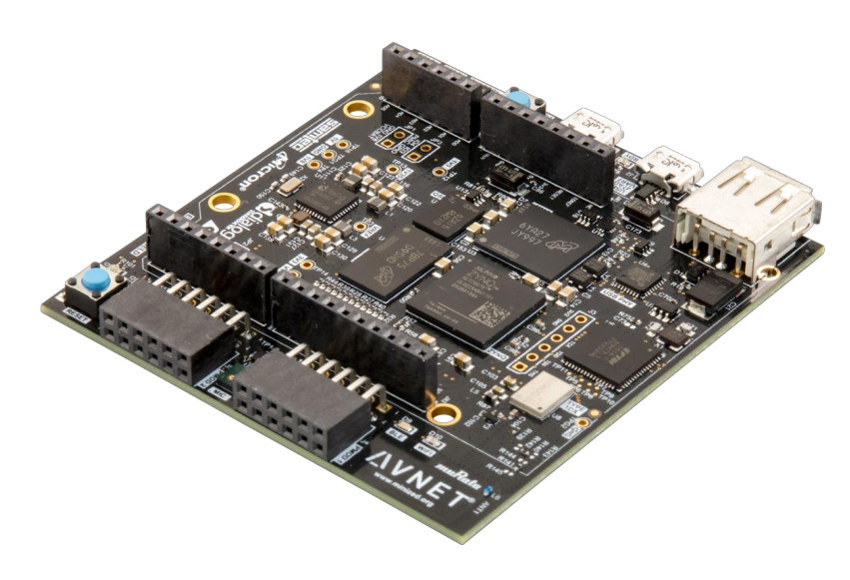
Digilent MiniZed FPGA board
Xilinx Zynq XC7Z007S SoC (Zynq 7000)
Single ARM Cortex A9 core
512MB DDR …
We try to provide one board for each student

Slide 10
Reading Assignments + Seminars
Cutting-edge research papers on acceleration
Presented either individually, or in groups of two (you can choose)
Each presentation ~10min, with a short discussion afterwards

Slide 11
New this year
Technique details behind ChatGPT
What is ChatGPT, what is GPT? Why it is so ”smart”
What can ChatGPT do, what can it not.
What ChatGPT is good at, what it is bad at.
Etc…

Slide 12

Pedagogical Strategy
Yay!
To engage the students
In active learning
Didn’t
“get it”
Introduction to the “big picture.”
Real-world demos.
“Got it”
Invoke critical thinking
Why is that?
What if …
In-class quizzes.
Pass
Did not pass
Many other more …
Source: Kember and McNaught, Enhancing University Teaching: Lessons from Research into Award-Winning Teachers, 2007.
Notes:
First thing first, my pedagogical strategy
According to previous research, the students taking up a
Course can be put into four groups.
In the first group, the students didn’t get the knowledge and fail the exam.
We always experience a small group of such students in nearly every course.
The second group is that the students got the knowledge and pass the exam.
This is actually what most of the students do.
While we believe that no students will get the knowledge but fail their exam on purpose,
We observe that there are indeed a lot of students who did not get the knowledge but somehow pass the exam! Magic!
But actually those are our problematic children since we really don’t know
How the students are performing based on their performance.
The reason is that
The students in this red group are merely passively focusing on the knowledge
That we are teaching, without actively taking part in the class.
To solve this problem, my approach is that before heading into details,
I will introduce the students with how the whole game looks like
Using real-world demos to engage the students into active learning.
We also intrigue students to critically think on questions such as why is that?
what if it does not happen in that way?
We can also let the students actively participate in the in-class quizzes.
Anyway, we can do many things to make our class interesting, and useful.
After talking about the big picture, we can then focus on more detailed things, that
Is, all those techniques we want to teach the students.
In this lecture, I will use both real-world demos, and in class quizzes, as well as critical
Thinking, to make
We will see later how this pedagogical strategy is used for this lecture.

Slide 13
Grade
To pass the course, you should attend all lectures, labs, project lectures, seminars, etc.
On basis of the attendance, your final grade will be based on your project implementation:
Pure SW implementation: 3
Pure HW implementation: 4
SW/HW co-design: 5

Slide 14
Enjoy your course! <yuan.yao@it.uu.se>

